Slide 1


Institute Name: | Silver Oak College of Computer Application
Programme Name: | Master Of Computer Application | Semester: | I
Course Code: | CAM5011C | Course Name: | Database Management System
Unit No.: | 1 | Unit Name: | Introduction to Database

Slide 2

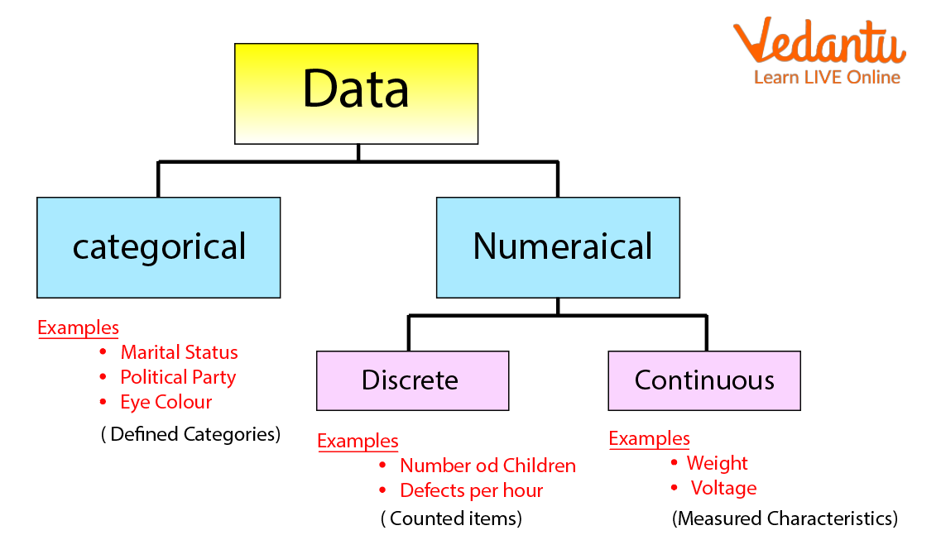
DATA
Data is a raw and unorganized fact that required to be
processed to make it meaningful.
Facts, figures, statistics etc. having no particular meaning
Data can be simple at the same time unorganized unless
it is organized.
Generally, data comprises facts, observations,
  perceptions numbers,
  characters, symbols, image,etc.
Ex:- A Student’s marks in different subject:
  85 , 68 , 90 ,85 ,75 ( these are raw data)
  (e.g. 1, ABC, 19 etc)

Slide 3
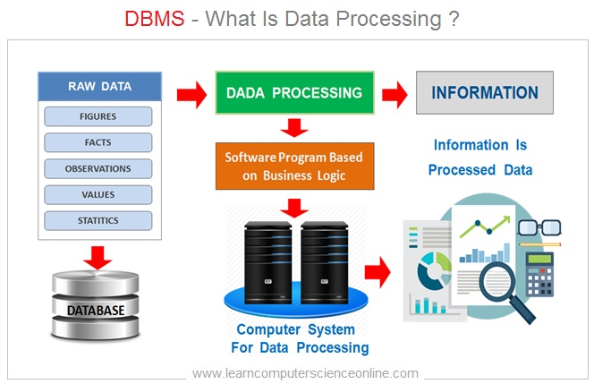
INFORMATION
Information is a set of data which is processed in a meaningful way according to the given requirement.
Information assigns meaning and improves the reliability of the data .
Knowledge acquired through study or experience.
Information helps human being in their decision making.

Slide 4
DATABASE
The database is a collection of inter-related data which is used to retrieve, insert and delete the data efficiently.
It is also used to organize the data in the form of a table, schema, views, and reports, etc.
Basic Example: Dictionary , Airline Database , Student Database , Library, Railway Timetable etc.
For example: The college Database organizes the data about the admin, staff, students and faculty etc. Using the database, we can easily retrieve, insert, and delete the information
Roll_Name | Name | Age
1 | ABC | 19
2 | XYZ | 22
3 | PQR | 28

Slide 5
INTRODUCTION
DBMS : Database management System.
DBMS is a software system for creating , organizing and managing the database.
It provide an environment to the user to perform operation on the database for creation, insertion, deletion, updating and retrieval of data.
A DBMS provides an interface between the user/application and the database.
Example: MySQL, Oracle, PostgreSQL, Microsoft SQL Server, and SQLite.

Slide 6
Applications of DBMS
Banking- Stores customer accounts, transactions, loans, and ATM records.
Ensures secure and accurate financial data management.
Hospital Management-Maintains patient records, doctor details, appointments, and billing.
Helps improve healthcare services and data accessibility.
Education-Manages student information, attendance, exams, grades, and fees.
Used by schools, colleges, and universities.
Railway and Airline Reservation-Handles ticket booking, cancellations, schedules, and passenger details.
Supports real-time seat availability.
E-commerce-Stores product details, customer information, orders, and payment records.
Enables efficient online shopping and inventory management.
Library Management-Keeps records of books, members, borrowing, and returns.
Reduces manual work and improves tracking.
Telecommunication-Manages customer data, call records, billing, and recharge information.
Supports millions of users efficiently.
Retail and Inventory Management-Tracks products, stock levels, sales, and supplier information.
Helps prevent overstocking or stock shortages.
Human Resource Management (HRM)-Stores employee details, payroll, attendance, and performance records.
Simplifies workforce management.
Government Organizations-Maintains records such as voter IDs, passports, tax information, and census data.
Improves public service efficiency and data security.

Slide 7

FILE SYSTEM V/S DBMS
FILE SYSTEM
DBMS
File system is a collection of data. In this system, the user has to write the procedures for managing the database.
File system provides the detail of the data representation and storage of data.
File system doesn't have a crash mechanism, i.e., if the system crashes while entering some data, then the content of the file will lost.
It is very difficult to protect a file under the file system.
File system can't efficiently store and retrieve the data.
In the File system, concurrent access has many problems like redirecting the file while other deleting some information or updating some information.
DBMS is a collection of data. In DBMS, the user is not required to write the procedures.
DBMS gives an abstract view of data that hides the details.
DBMS provides a crash recovery mechanism, i.e., DBMS protects the user from the system failure.
DBMS provides a good protection mechanism.
DBMS contains a wide variety of sophisticated techniques to store and retrieve the data.
DBMS takes care of Concurrent access of data using some form of locking.

Slide 8
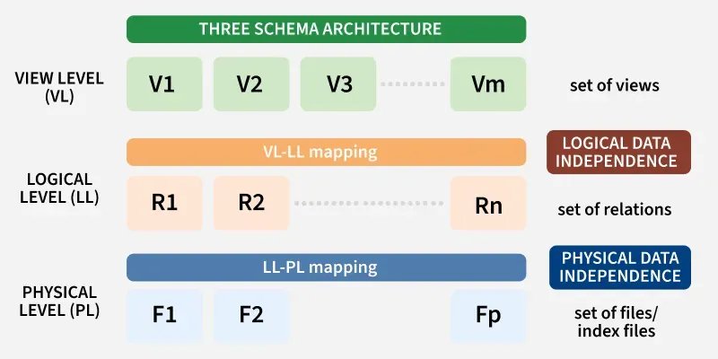
Data Independence
Data Independence is a fundamental concept in Database Management Systems (DBMS) that refers to the ability to modify the schema at one level of the database without affecting the schema at the next higher level.
This concept ensures that changes in how data is stored or structured internally do not impact how users or applications access and interact with the data.

Slide 9
Types of Data Independence
Physical Data Independence
Logical Data Independence
Focuses on how data is stored physically
Deals with the internal schema
Changes don’t affect application programs
It tells about the internal schema.
Easier to achieve
Used for performance and storage optimization
Example: Moving data files or adding indexes.
Focuses on structure and organization of data.
Deals with the conceptual schema
Changes may require updates in application programs
It tells about the conceptual schema.
More difficult to achieve
Used for evolving database design .
Example: Adding or removing a column in a table

Slide 10
Architecture in DBMS
In a Database Management System (DBMS), the architecture defines how the database and its components interact with the end users or applications. The Two-Tier and Three-Tier architectures are commonly used in modern database applications. These architectures determine how the data, user interface, and businesslogic are separated and interact with each other.
1-Tier Architecture
In 1-Tier Architecture, the user works directly with the database on the same system. This means the client, server and database are all in one application. The user can open the application, interact with the data and perform tasks without needing a separate server or network connection.
• A common example is Microsoft Excel. Everything from the user interface to the logic and data storage happens on the same device. The user enters data, performs calculations and
Saves files directly on their computer.

Slide 11
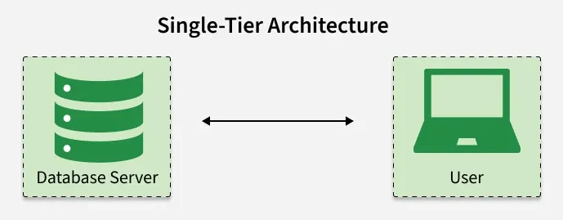
1-Tier Architecture
• This setup is simple and easy to use, making it ideal for
personal or standalone applications. It does not require a
network or complex setup, which is why it's often used in
small-scale or individual use cases.
• This architecture is simple and works well for personal,
standalone applications where no external server or network connection is needed.

Slide 12
Advantage & Disadvantage of 1 Tier Architecture
Advantage
Disadvantage
Simple Architecture: 1-Tier Architecture is the most simple architecture to set up, as only a single machine is required to maintain it.
Cost-Effective: No additional hardware is required for implementing 1-Tier Architecture, which makes it cost-effective.
Easy to Implement: 1-Tier Architecture can be easily deployed and hence it is mostly used in small projects.Architecture is the most simple architecture to set up, as only a single machine is required to
Limited to Single User: Only one person can use the application at a time. It’s not designed for multiple users or teamwork.
Poor Security: Since everything is on the same machine, if someone gets access to the system, they can access both the data and the application easily.
No Centralized Control: Data is stored locally, so there's no central database. This makes it hard to manage or back up data across multiple devices.
Hard to Share Data: Sharing data between users is difficult because everything is stored on one computer.

Slide 13
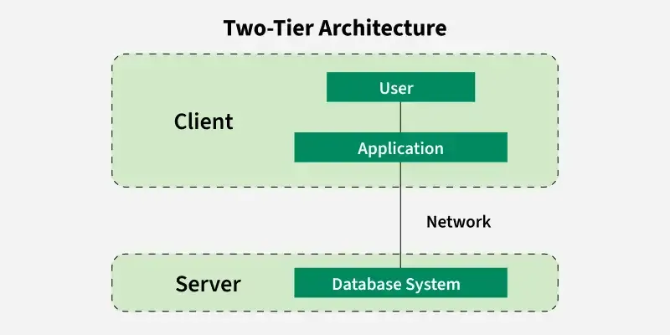
2-Tier Architecture
The 2-tier architecture is similar to a basic client-server model. The application at the client end directly communicates with the
database on the server side. APIs like ODBC and JDBC are used
for this interaction. The server side is responsible for providing
query processing and transaction management functionalities.
On the client side, the user interfaces and application programs are run. The application on the client side establishes a connection with the server side to communicate with the DBMS.
For Example: A Library Management System used in schools or small organizations is a classic example of two-tier architecture.

Slide 14
2-Tier Architecture
Client Layer (Tier 1): This is the user interface that library staff or users interact with. For example they might use a desktop
application to search for books, issue them, or check due dates.
• Database Layer (Tier 2): The database server stores all the library records such as book details, user information and transaction logs.
• The client layer sends a request (like searching for a book) to the database layer which processes it and sends back the result. This separation allows the client to focus on the user

Slide 15
Advantage & Disadvantage of 2 Tier Architecture
Advantage
Disadvantage
Easy to Access: 2-Tier Architecture makes easy access to the database, which makes fast retrieval.
Scalable: We can scale the database easily, by adding clients or upgrading hardware.
Low Cost: 2-Tier Architecture is cheaper than 3-Tier Architecture and Multi-Tier Architecture.
Easy Deployment: 2-Tier Architecture is easier to deploy than 3-Tier Architecture.
Simple: 2-Tier Architecture is easily understandable as well as simple because of only two components.
Limited Scalability: As the number of users increases, the system performance can slow down because the server gets overloaded with too many requests.
Security Issues: Clients connect directly to the database,which can make the system more vulnerable to attacks or data leaks.
Tight Coupling: The client and the server are closely linked. If the database changes, the client application often needs to be updated too.
Difficult Maintenance: Managing updates, fixing bugs, oradding features becomes harder when the number of users or systems increases.

Slide 16
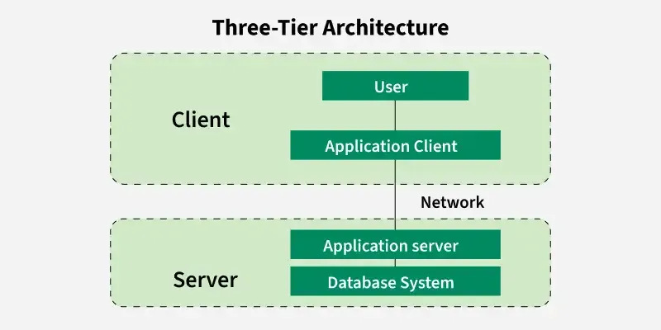
3-Tier Architecture
In 3-Tier Architecture, there is another layer between the client and the server. The client does not directly communicate with the server. Instead, it interacts with an application server which further communicates with the database system and then the query processing and transaction management takes place.
This intermediate layer acts as a medium for the exchange of partially processed data between the server and the client. This type of architecture is used in the case of large web applications.

Slide 17
3-Tier Architecture
Example: E-commerce Store
• User: You visit an online store, search for a product and add it to your cart.
• Processing: The system checks if the product is in stock,calculates the total price and applies any discounts.
• Database: The product details, your cart and order history are stored in the database for future reference.

Slide 18
Advantage & Disadvantage of 3 Tier Architecture
Advantage
Disadvantage
Enhanced scalability: Scalability is enhanced due to the distributed deployment of application servers. Now, individual connections need not be made between the client and server.
Data Integrity: 3-Tier Architecture maintains Data Integrity. Since there is a middle layer between the client and the server, data corruption can be avoided/removed.
Security: 3-Tier Architecture Improves Security. This type of model prevents direct interaction of the client with the server thereby reducing access to unauthorized data.
More Complex: 3-Tier Architecture is more complex incomparison to 2-Tier Architecture. Communication Points arealso doubled in 3-Tier Architecture.
Difficult to Interact: It becomes difficult for this sort of interaction to take place due to the presence of middle layers.
Slower Response Time: Since the request passes through an extra layer (application server), it may take more time to get a response compared to 2-Tier systems.
Higher Cost: Setting up and maintaining three separate layers (client, server and database) requires more hardware, softwareand skilled people. This makes it more expensive.

Slide 19
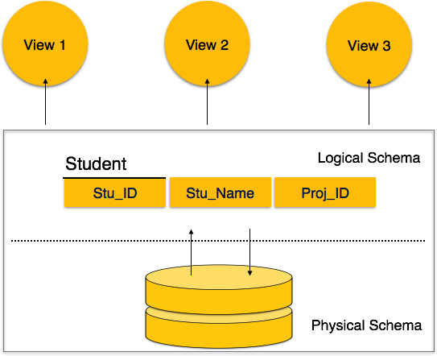
Database Schema
A database schema is the skeleton structure that represents the logical view of the entire database. It defines how the data is organized and how the relations among them are associated. It formulates all the constraints that are to be applied on the data.
A database schema defines its entities and the relationship among them. It contains a descriptive detail of the database, which can be depicted by means of schema diagrams. Its the database designers who design the schema to help programmers understand the database and make it useful.

Slide 20
A database schema can be divided broadly into two categories −
Physical Database Schema −
This schema pertains to the actual storage of data and its form of storage like files, indices, etc. It defines how the data will be stored in a secondary storage.
Logical Database Schema −
This schema defines all the logical constraints that need to be applied on the data stored. It defines tables, views, and integrity constraints.

Slide 21
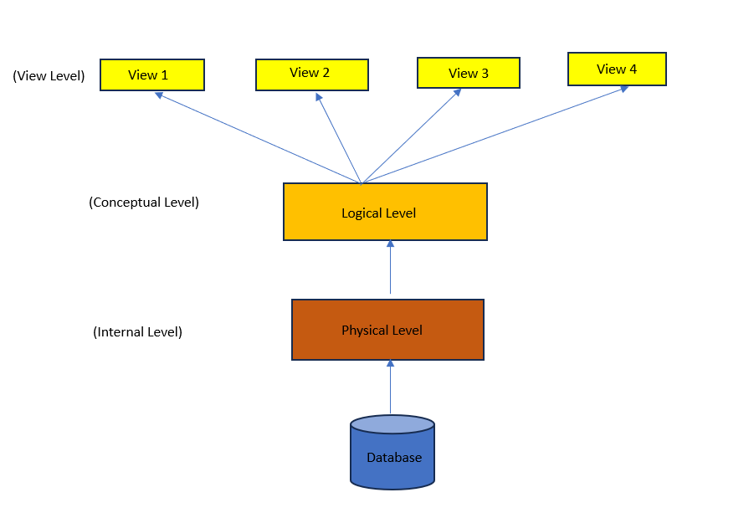
DATA ABSTRACTION
Data abstraction hides unwanted details, showing users only relevant data.
It keeps data safe by hiding how and where data is stored.
Abstraction simplifies access while maintaining data security and efficiency.
For example, while buying clothes, users see only color, size, and brand, not production details.
Levels of Abstraction in DBMS
There are three levels of data abstraction in DBMS that are mentioned below:
Physical or Internal level
Logical or Conceptual level
View or External level

Slide 22
Physical or Internal Level
It is the lowest level of data abstraction which defines how data is stored in database . It defines data structures used to store data and methods to access data in database. It is very complex to understand and hence kept hidden from user. Database administrator decides how and where to store the data in database.
Physical level deals with actual storage details like data organization, disk space allocation and data access methods.
Logical or Conceptual Level
It is intermediate level present next to physical level. It defines what data is present in database and their relationships between them . It is less complex as compared to physical level. Programmers generally work at this level and depending on data, structure of tables, relationships and their constraints is decided at this level.
View or External Level
It is the highest level in abstraction. There are different levels of views and each view defines only a part of whole data required to user. This level defines many views of same database for simplification of view to user. This is the highest level and easiest to understand for user.

Slide 23
The Codd’s rules
Ru
Rule 5: The Comprehensive Data Sublanguage Rule
Relational systems can support multiple languages and different modes of using terminals, such as fill-in-the-blanks mode. However, there must be at least one language whose statements are expressible according to a well-defined syntax.
Rule 6: The View Updating Rule
Theoretically, updatable views are also practically updatable by the database system.
Rule 7: High-Level Insert, Update & Delete Rule
The database system must follow high-level relational operations such as insertion, updation, and deletion at each level or row by row. It also supports the union, intersection, and subtraction operations in database systems.
Rule 8: Physical Data Independence
The working of a database system should be independent of the physical storage of its data. If a file is modified (renamed or moved to another location), it should not interfere with the working of the system.

Slide 24
Mapping
Mapping in DBMS is the process of converting an Entity-Relationship (ER) model into a relational database structure consisting of tables, columns, primary keys, and foreign keys.
Types of Mapping
One-to-One (1:1)
One entity is related to only one entity of another set.
Example: One person has one passport.
One-to-Many (1:N)
One entity can be related to many entities.
Example: One department has many students.
Many-to-One (N:1)
Many entities are related to one entity.
Example: Many students belong to one department.
Many-to-Many (M:N)
Many entities can be related to many other entities.
Example: Students can enroll in many courses, and each course can have many students.
Mapping Weak Entities
A weak entity depends on a strong entity for its identification. A foreign key of the strong entity is included in the weak entity's table.

Slide 25
Users and DBA
In a Database Management System (DBMS), different people interact with the database for different purposes. They are broadly classified as Database Users and Database Administrators (DBA).
1. Database Users
Database users are people who access and use the database to perform various operations such as entering, retrieving, updating, and analyzing data.
Types of Database Users
1. Naive or Parametric Users
These users have little or no knowledge of the database system. They use predefined applications or forms to access data.
Examples:
Bank customers using ATMs
Railway reservation users
Employees entering attendance data
They normally perform simple, repetitive operations.

Slide 26
Users and DBA
2. Application Programmers
Application programmers develop programs and applications that interact with the database.
Examples:
Developing a banking application
Creating a college management system
Developing an online shopping application
They use programming languages and SQL to access the database.
3. Sophisticated Users
Sophisticated users have good knowledge of databases and can directly interact with the DBMS using SQL or other database tools.
Examples:
Data analysts
Engineers
Researchers
Business analysts
They may write complex queries to analyze large amounts of data.

Slide 27
Users and DBA
4. Database Designers
Database designers are responsible for designing the structure of the database. They decide:
What tables are required
What attributes each table should contain
Relationships between tables
Primary and foreign keys
Constraints and rules
Their goal is to create an efficient and well-organized database.

Slide 28
DBA (Database Administrator)
DBA - Database Administrator
A Database Administrator (DBA) is a person who manages and maintains a database system. The main aim of a DBA is to keep the database secure, available, accurate, and efficient.
A DBA performs tasks such as database installation, configuration, user management, security, performance monitoring, backup, recovery, troubleshooting, migration, and system upgrades.
Types of DBA
Administrative DBA:
Manages database servers, security, backups, recovery, and troubleshooting.
Development DBA:
Creates and manages SQL queries, stored procedures, and database programs.
Application DBA:
Manages databases used by specific applications and handles upgrades and data loading.
Cloud DBA:
Manages databases hosted on cloud platforms and ensures security, availability, and scalability.
Data Warehouse DBA:
Manages data warehouses and handles data integration, cleaning, and storage.
Database Architect:
Designs database structure, schemas, tables, and relationships.

Slide 29
DBA (Database Administrator)
OLAP DBA:
Manages multidimensional databases and OLAP systems used for data analysis.
Task-Oriented DBA:
Focuses on specific tasks such as backup, recovery, or security.
Database Analyst:
Helps with database analysis, design, and improvement.Importance of DBA
A DBA is important because they:
Manage and maintain the database system.
Protect data from unauthorized access.
Maintain data integrity and consistency.
Create backups and recover data when needed.
Control user access and permissions.
Monitor and improve database performance.
Manage database capacity and storage.
Handle system failures, migration, and upgrades.

Slide 30
Data Model
Data Model
A data model is a visual and logical representation of an organization data elements and the relationships between them. It helps structure and organize data in alignment with business processes, enabling effective communication between business users and technical teams. Data models define how data is stored, accessed, shared and maintained across information systems
Types of Data Model:
Hierarchical Data Model
Network Data Model
Relational Data Model
E-R Data Model

Slide 31
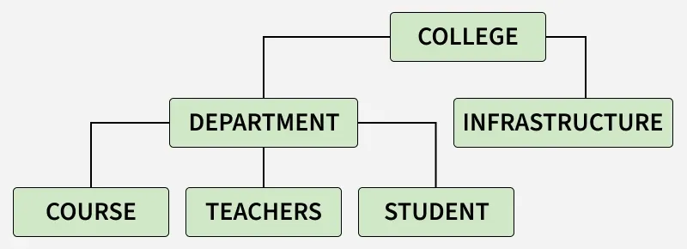
Hierarchical Data Model
1. Hierarchical Model: The structure of the hierarchical model resembles a tree. The remaining child nodes are arranged in a certain sequence and there is only one root node or alternatively one parent node. However the hierarchical approach is no longer widely applied. approach connections in the actual world may be modelled using this approach.

Slide 32
Hierarchical Data Model
Advantages of the Hierarchical Data Model
• Because of its tree form, it is easy to grasp.
• Retrieving data in a one-to-many connection is efficient.
Disadvantages of the Hierarchical Data Model
• Inflexibility in reorganizing data.
• accessing complicated data structures may be challenging.
• redundant data storage, which might cause anomalies and inconsistencies.

Slide 33
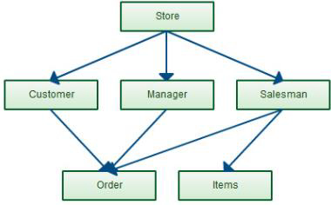
Network Data Model
Network Model: We have to represent objects and the relationships using the network model. One of its features is a schema, which is a graph representation of the data. An item is stored within a node and the relationship between them is represented as an edge. This allows them to generalise the maintenance of many parent and child records.

Slide 34
Network Data Model
Advantages of the Network Data Model
• Because of its numerous parent ties, it is more adaptable than
the hierarchical approach.
• Ideal for managing intricate, many-to-many connections.
Disadvantages of the Network Data Model
• Increased complexity in database design and management.
• requires complex programming in order to manage and work
with data.

Slide 35
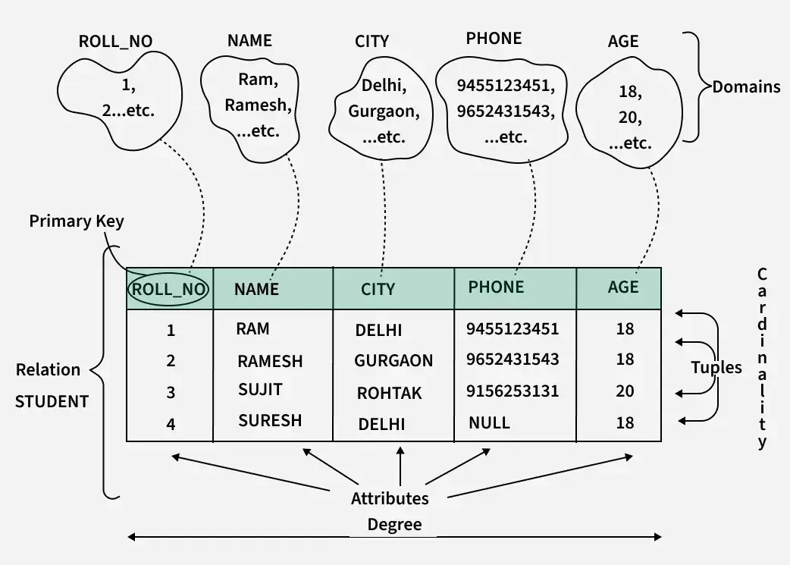
Relational Data Model
Relational Model: Relational Mode represent the links between tables by representing data as rows and columns in tables. It is frequently utilised in database design and is strongly related to relational database management systems (RDBMS).

Slide 36
Relational Data Model
Advantages of the Relational Data Model
• High data independence and flexibility.
• offers robust and user-friendly querying features.
• removes duplication by use of normalization.
Disadvantages of the Relational Data Model
• For certain kinds of straightforward data retrieval tasks, they
may not perform as well as hierarchical models.
• demands a deeper comprehension of SQL and normalization
principles.

Slide 37
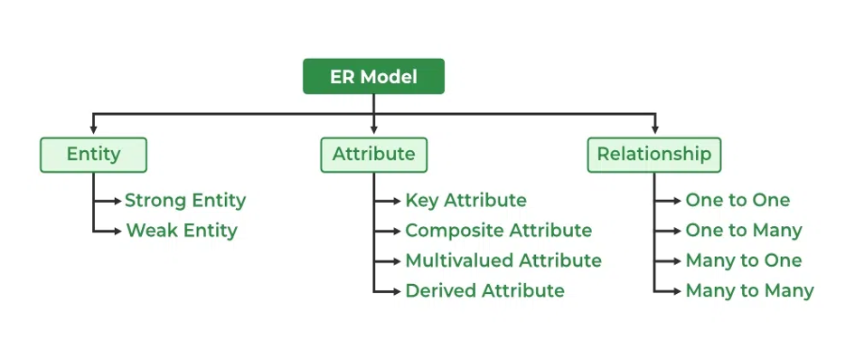
ER Data Model
The Entity-Relationship Model (ER Model) is a conceptual model for designing a database. This model represents the logical structure of a database, including entities, their attributes, and relationships between them.
Entity: An object that is stored as data. E.g: Student, Course, or Company.
Attribute: Properties that describe an entity. E.g: StudentID, CourseName, or EmployeeEmail.
Relationship: A connection between entities. E.g: Student enrolls in a Course

Slide 38
ER Data Model
Uses of ER Diagrams in DBMS
ER diagrams represent the E-R model in a database, making them easy to convert into relations (tables).
These diagrams serve the purpose of real-world modeling of objects which makes them intently useful.
Unlike technical schemas, ER diagrams require no technical knowledge of the underlying DBMS used.
They visually model data and its relationships, making complex systems easier to understand.
Advantages of E–R Model
Easy to understand and visualize.
Helps in designing databases efficiently.
Reduces data redundancy.
Provides a clear blueprint before implementation.

Slide 39
Comparison of Data Models
Basis | Hierarchical Model | Network Model | Relational Model | E-R Model
Structure | Tree | Network/Graph | Tables | Diagram
Data | Records | Records | Rows and columns | Entities and attributes
Relationship | Parent–Child | Linked records | Tables linked by keys | Entities connected by relationships
Relationship Type | Mainly 1:M | 1:1, 1:M, M:N | 1:1, 1:M, M:N | 1:1, 1:M, M:N
Flexibility | Low | Medium | High | High

Slide 40
Comparison of Data Models
Basis | Hierarchical Model | Network Model | Relational Model | E-R Model
Complexity | Simple | Complex | Simple | Easy to understand
Data Access | Fixed path | Links/Pointers | SQL queries | Conceptual design
Storage | Tree structure | Network structure | Tables | Not directly stored
Main Use | Hierarchical data | Complex relationships | Database management | Database design
Example | Company → Employees | Students ↔ Courses | Student table | Student — Enrolls — Course

